Slide 1
Fundamental Concepts
Abstraction—data, procedure, control
Architecture—the overall structure of the software
Patterns—”conveys the essence” of a proven design solution
Separation of concerns—any complex problem can be more easily handled if it is subdivided into pieces
Modularity—compartmentalization of data and function
Information Hiding—controlled interfaces
Functional independence—single-minded function and low coupling
Refinement—elaboration of detail for all abstractions
Aspects—a mechanism for understanding how global requirements affect design
Refactoring—a reorganization technique that simplifies the design
OO design concepts—Appendix II
Design Classes—provide design detail that will enable analysis classes to be implemented

Slide 2
Refinement
Abstraction and refinement are complimentary concepts
Refinement means going into the details of the system via idea refinement
Refine the requirement by decomposing it
until it reaches to the state where it clearly elaborates the system.
Abstraction shows the procedures and data whereas the refinement shows the implementation and low level details

Slide 3
Stepwise Refinement
open
walk to door;
reach for knob;
open door;
repeat until door opens
turn knob clockwise;
walk through;
if knob doesn't turn, then
close door.
take key out;
find correct key;
insert in lock;
endif
pull/push door
move out of way;
end repeat

Slide 4
Architecture
Shows the overall structure of the software and the way in which the Structure provides conceptual integrity for a system.
Architecture design = structure of data + program components needed for system
Just a blue print of overall system, not a operational component
Show dataflow, control flow, dependencies.
Conceptual integrity is the property of a system to work on a consistent set of concepts, such as entities (user, groups, posts) or operations (transfer money to an account or convert it in different currencies). If a railway system has three different websites for selling tickets (I know of at least one case), each with different functionalities, its overall system lacks conceptual integrity.
Architectural design can be represented using following models:
Structural models ->show arch as organized collection of components
Framework models ->more abstract design , hiding the repeatable components
Dynamic models -> show how program structure may change because of an external event
Process models ->focus on functional requirements related to business process design and implementation
Functional models -> represent system functionality hierarchy wrt dependence

Slide 5
Architecture design properties
Structural properties. defines the:
components of a system (e.g., modules, objects, filters) and
the manner in which those components are packaged
and interact with one another.
For example, objects are packaged to encapsulate both data and the processing that manipulates the data and interact via the invocation of methods
Extra-functional properties.
Show how the design architecture achieves requirements for:
performance, capacity, reliability, security, adaptability, and other system characteristics.
Families of related systems. The architectural design should draw upon repeatable patterns that are commonly encountered in the design of families of similar systems.
In essence, the design should have the ability to reuse architectural building blocks.

Slide 6
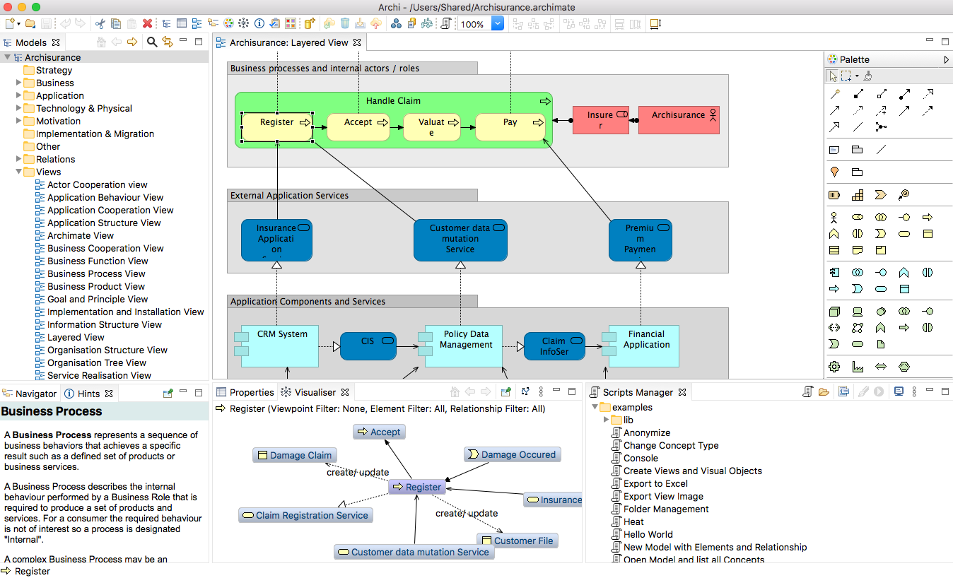
Architecture Design developed using ArchiMate tool

Slide 7
Separation of Concerns
Any complex problem can be more easily handled if it is subdivided into pieces that can each be solved and/or optimized independently
A concern -> feature /behavior that is specified as part of the requirements model for the software(something that is of interest or significance to a stakeholder or a group of stakeholders).
By separating concerns into smaller, and therefore more manageable pieces, a problem takes less effort and time to solve.
shown in other design concepts like refinement, modularity, functional independence, aspects.

Slide 8
Modularity
Modularity is the implementation of separation of concerns
Software is decomposed in to separately named addressable components called as modules
They are integrated to fulfil the set of requirements
Follow divide and conquer approach
Monolithic software (i.e., a large program composed of a single module) cannot be easily grasped by a software engineer.
The number of control paths, span of reference, number of variables, and overall complexity would make understanding close to impossible.
In almost all instances, you should break the design into many modules, hoping to make understanding easier and as a consequence, reduce the cost required to build the software.
This module break down must be to an optimum level because more modules leads to more integration cost.

Slide 9
Modularity: Trade-offs
What is the "right" number of modules
for a specific software design?
module development cost
cost of
software
module
integration
cost
optimal number
number of modules
of modules

Slide 10
Information Hiding
module
• algorithm
controlled
interface
• data structure
• details of external interface
• resource allocation policy
clients
"secret"
a specific design decision

Slide 11
Why Information Hiding?
Modularity leads to access of information to particular entities.
Information hiding is used to enforce the access constraints to a local details as well as the data structures used.
emphasizes communication through controlled interfaces
discourages the use of global data
leads to encapsulation—an attribute of high quality design
results in higher quality software
Modules are the ones that are not dependent and they don’t want their data to get shared

Slide 12
Refactoring
Simplifies the design of a component without changing its behaviour by eliminating redundant codes and designs that might lead to system failures.
So improves the internal structure of the system without disturbing the external behavior of the code
When software is refactored, the existing design is examined for
redundancy
unused design elements
inefficient or unnecessary algorithms
poorly constructed or inappropriate data structures
or any other design failure that can be corrected to yield a better design.

Slide 13
Functional Independence
Design a software in a way that can each module addresses a subset of requirements and it has an interface when viewed form other modules.
Advantages:
Easy to develop
Easy task scheduling
Less error propagation chances
Reusable modules
Independence is assessed using two criteria:
Cohesion is an indication of the relative functional strength of a module.
A cohesive module performs a single task, requiring little interaction with other components in other parts of a program. Stated simply, a cohesive module should (ideally) do just one thing.
Coupling is an indication of the relative interdependence among modules.
Coupling depends on the interface complexity between modules, the point at which entry or reference is made to a module, and what data pass across the interface.

Slide 14
Aspects
Consider two requirements, A and B. Requirement A crosscuts requirement B “if a software decomposition [refinement] has been chosen in which B cannot be satisfied without taking A into account. [Ros04]
An aspect is a representation of a cross-cutting concern.

Slide 15
Aspects—An Example
Consider two requirements for the SafeHomeAssured.com WebApp.
Requirement A is described via the use-case Access camera surveillance via the Internet. A design refinement would focus on those modules that would enable a registered user to access video from cameras placed throughout a space.
Requirement B is a generic security requirement that states that a registered user must be validated prior to using SafeHomeAssured.com. This requirement is applicable for all functions that are available to registered SafeHome users.
As design refinement occurs, A* is a design representation for requirement A and B* is a design representation for requirement B. Therefore, A* and B* are representations of concerns, and B* cross-cuts A*.
An aspect is a representation of a cross-cutting concern. Therefore, the design representation, B*, of the requirement, a registered user must be validated prior to using SafeHomeAssured.com, is an aspect of the SafeHome WebApp.

Slide 16
OO Design Concepts
Design classes
Entity classes (represents system data)
Boundary classes (Objects that interface with system actors)
Windows, screens and menus are examples of boundaries that interface with users.
Controller classes (Objects that mediate between boundaries and entities.)
Inheritance—all responsibilities of a superclass is immediately inherited by all subclasses
Messages—stimulate some behavior to occur in the receiving object
Polymorphism—a characteristic that greatly reduces the effort required to extend the design

Slide 17
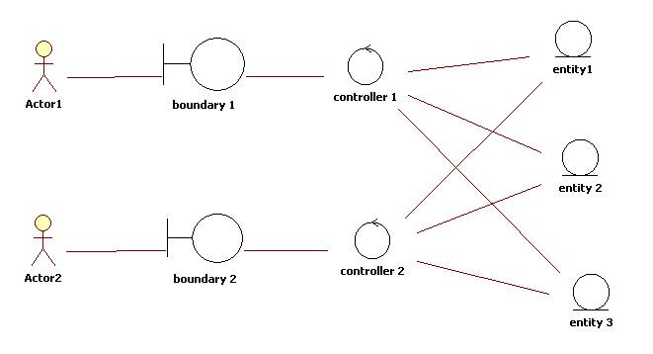
OO Design Concepts

Slide 18
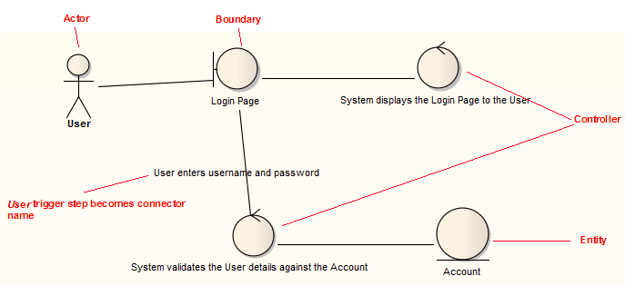
OO Design Concepts

Slide 19
Design Classes
Analysis classes are refined during design to become entity classes
Boundary classes are developed during design to create the interface (e.g., interactive screen or printed reports) that the user sees and interacts with as the software is used.
Boundary classes are designed with the responsibility of managing the way entity objects are represented to users.
Controller classes are designed to manage
the creation or update of entity objects;
the instantiation of boundary objects as they obtain information from entity objects;
complex communication between sets of objects;
validation of data communicated between objects or between the user and the application.

Slide 20
Design Model Elements
Data elements
Data model --> data structures
Data model --> database architecture
Architectural elements
Application domain
Analysis classes, their relationships, collaborations and behaviors are transformed into design realizations
Patterns and “styles”
Interface elements
the user interface (UI)
external interfaces to other systems, devices, networks or other producers or consumers of information
internal interfaces between various design components.
Component elements
Deployment elements

